Slide 1


Early-Stage Alzheimer's Disease Prediction By Nanditha
Using Decision Tree Machine Learning Algorithm
(Multi class classification)
Presented By,
Nanditha J K

Slide 2
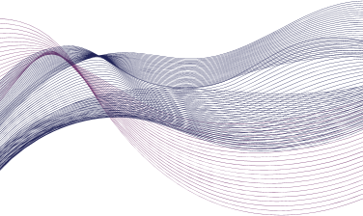
Introduction
Alzheimer’s disease (AD) is characterized by the accumulation of amyloid plaques and neurofibrillary tangles in the brain, leading to progressive neuronal damage and cognitive decline. Symptoms often begin with memory loss and confusion, eventually impacting language, reasoning, and daily functioning. Despite extensive research, there is currently no cure for AD, making early detection and management critical for improving patient outcomes.

Slide 3

Objective
Alzheimer’s disease (AD) is a widespread neurodegenerative condition affecting over 32 million people globally. It typically begins with an asymptomatic stage, progressing to mild cognitive impairment (MCI) before full-blown AD. Early diagnosis is crucial for managing the disease effectively, but current biomarkers like medial temporal atrophy detected by MRI scans are often insufficient in the earliest stages.
Machine learning (ML) offers promising solutions for early diagnosis by analyzing structural MRI data. Recent ML models have shown high accuracy in distinguishing between healthy individuals, those with MCI, and those with AD. By using advanced techniques, including graph theory features and multiple data sets, these ML tools can improve diagnostic precision, making early intervention more feasible. This innovative approach combines complexity and interpretability, ensuring that the diagnostic insights are both powerful and useful for clinicians.
Early and accurate diagnosis of Alzheimer’s disease (AD) is essential for disease management and therapeutic choices that can delay disease progression. Machine learning (ML) approaches have been extensively used in attempts to develop algorithms for reliable early diagnosis of AD, although clinical usefulness, interpretability, and generalizability of the classifiers across datasets and MRI protocols remain limited.

Slide 4
Overview
Data used in the preparation of this project was obtained from the publicly available Open Access Series of Imaging Studies (OASIS) project database taken from kaggle https://www.kaggle.com/code/pawelkauf/filling-the-gaps-exploring-alzheimer-s-data/input?select=oasis_longitudinal.csv
The dataset contains 373 subjects.
Subject ID: Unique identifier for each individual. This is typically used to distinguish between different records and should not be used as a feature in your predictive model.
MRI ID: A unique identifier for each MRI scan, ensuring that each scan can be accurately linked to the correct subject and visit.
Group: The diagnostic category of the subject: 1: Dementia 2: Non-dementia 3: Converted (patients who transitioned from non-dementia to dementia)
Visit: The number of times the patient has visited for evaluations. This helps in tracking changes over multiple sessions in longitudinal studies.
MR Delay: The time delay (in days) between the baseline visit and the MRI scan, accounting for any timing discrepancies that might affect the analysis.
M/F (Gender): Indicates the gender of the individual, with 'M' representing male and 'F' representing female. Gender can be a significant factor in the analysis of Alzheimer's disease.
Hand (Handedness): Indicates whether the individual is left-handed or right-handed. Handedness can sometimes be linked to brain lateralization and cognitive function.
Age: The age of the individual in years. Age is a critical factor in Alzheimer's research since the risk of developing Alzheimer's disease increases with age.

Slide 5
EDUC (Years of Education): Number of years of formal education. Education level has been studied as a potential protective factor against Alzheimer's disease, with higher education levels often associated with a lower risk.
SES (Socioeconomic Status): This is typically a categorical variable indicating the individual's socioeconomic status. SES can influence health outcomes and access to healthcare resources, which can impact Alzheimer's disease progression. (ordinal categorical: 1, 2, 3, 4, 5).
MMSE (Mini-Mental State Examination): A widely used test of cognitive function among the elderly. It includes tests of orientation, attention, memory, language, and visual-spatial skills. The MMSE score is often used to screen for cognitive impairment. Lower scores indicate greater cognitive impairment.
CDR (Clinical Dementia Rating): A numeric scale used to quantify the severity of symptoms of dementia (0, 0.5, 1, 2, or 3). It assesses six domains: memory, orientation, judgment & problem-solving, community affairs, home & hobbies, and personal care. Lower scores indicate normal or mild cognitive impairment, while higher scores indicate more severe dementia. 0: No dementia 0.5: Very mild dementia 1: Mild dementia 2: Moderate dementia 3: Severe dementia
eTIV (Estimated Total Intracranial Volume): An estimate of the total volume inside the skull(in cubic millimeters or other volumetric units). It is often used in neuroimaging studies to normalize brain volume measurements and account for differences in head size.
nWBV (Normalized Whole Brain Volume): The volume of the whole brain normalized to the individual's intracranial volume. This measure can help in comparing brain volumes across individuals with different head sizes and is important in studying brain atrophy associated with Alzheimer's disease, indicating the proportion of the intracranial volume occupied by the brain.
ASF: Atlas Scaling Factor, a numerical factor used to align MRI images to a standard template(atlas). It helps to standardize measurements across different individuals and imaging studies. It typically ranges from values close to 1, representing minimal scaling, to higher values indicating more significant adjustments.

Slide 6

Dataset Summary
Subject ID
151 unique ID
MRI ID
373 unique ID
(for each subject ID there
more than one MRI ID)
Group
(target variable)
Dementia
Not Dementia
Converted
MR Delay
MRI scanning report Delay (in minutes)
M/F
Male
Female
Hand
Right Handed
(all records)
Age
Alzheimer disease almost seen older age people
(60 –98)
EDUC. (6-22)
SES
1-low
2-low middle
3-middle
4-higher middle
5-high
eTIV
total volume inside the skull(in cubic millimeters) (1100-2000)
CDR
0: No dementia
0.5: Very mild dementia 1: Mild dementia
2: Moderate dementia
3: Severe dementia
nWBV
whole brain normalized to the individual's intracranial volume
(0.5-0.9)
ASF
ranges around 1.0
Visit
Number of subject visited
(1,2,3,4,5)

Slide 7
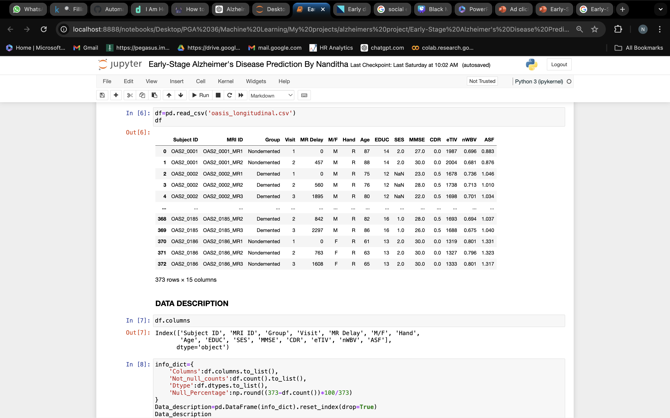
Dataset

Slide 8

Exploratory Data Analysis (EDA)
Data Preprocessing and Cleaning:
Investigate missing values, outliers, inconsistencies and duplicates in the ad click dataset. Explore data distribution and correlations to identify patterns and potential biases.
Feature Engineering and Selection:
Extract relevant features such as time-related variables
Exploratory Data Visualization:
Use interactive visualizations to explore relationships between features and target variables, aiding in model interpretation and validation.

Slide 9
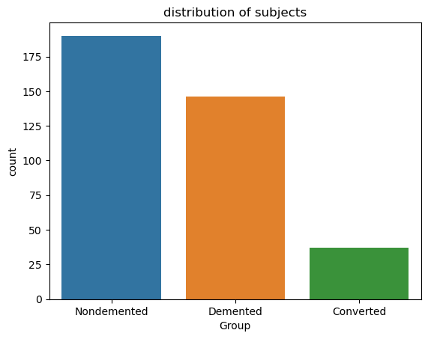
Target Variable Distribution of dementia , not dementia and converted
Non demented 190 Demented 146 Converted 37

Slide 10

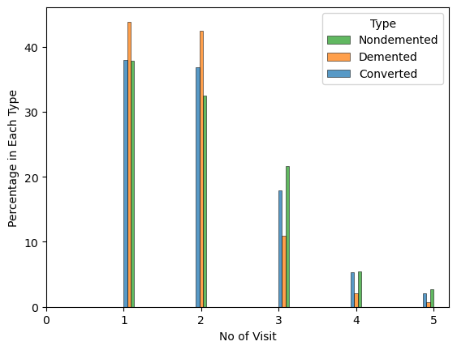
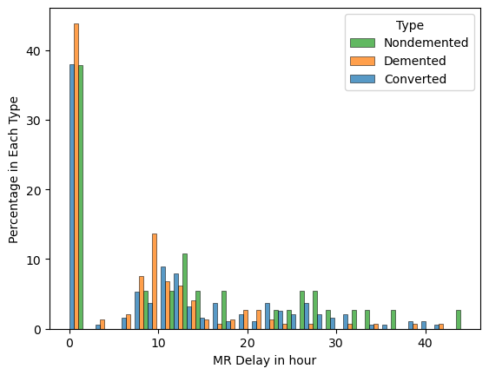
Number of visits
MRI scanning delay in hours
converted and non demented people visited most no of times
By above we can conclude that most of MRI scanning reports came within one hour, and apart from that report are almost with 15hours delay.ly

Slide 11
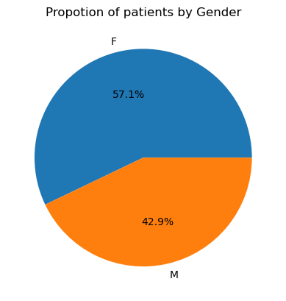
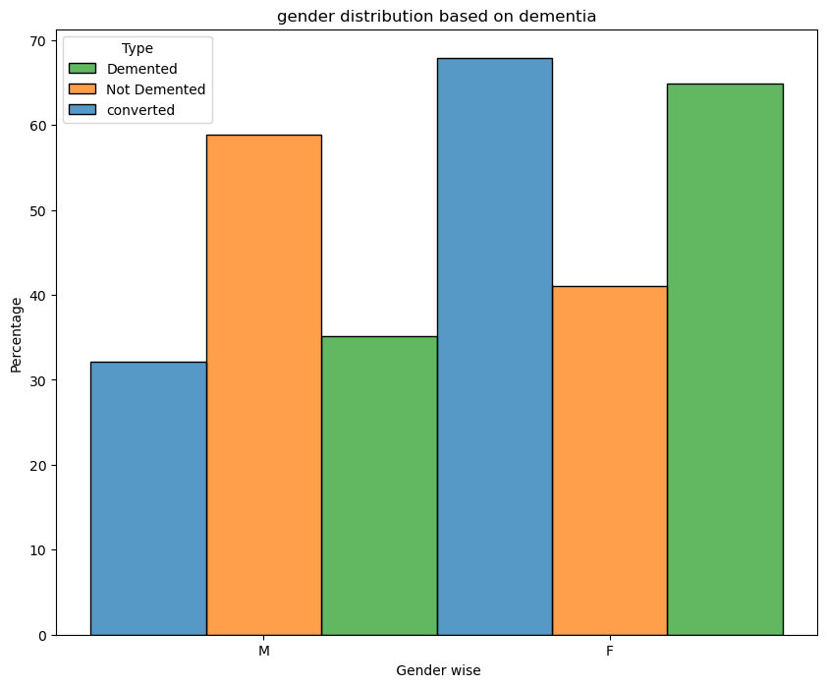
Proportion subjects by Gender
In the dataset, there's a slightly higher proportion of females 57.1% has seen the ads compared to males 42.9%, indicating higher female are subjected for testing.
The distribution indicates that females have a higher likelihood of developing Alzheimer's disease, and the data shows that a greater number of female subjects are affected by Alzheimer's compared to males.

Slide 12
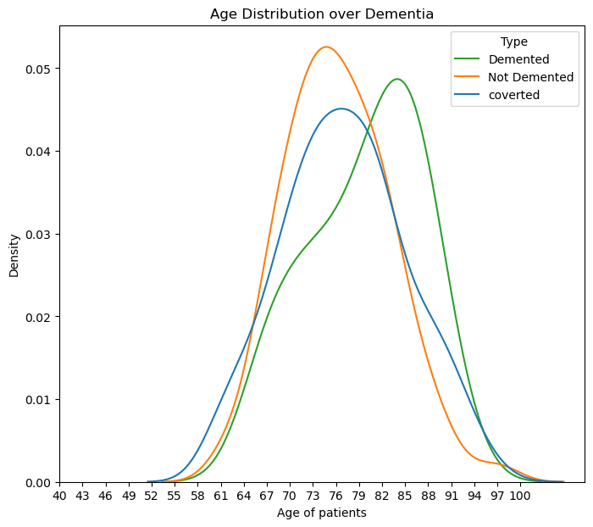
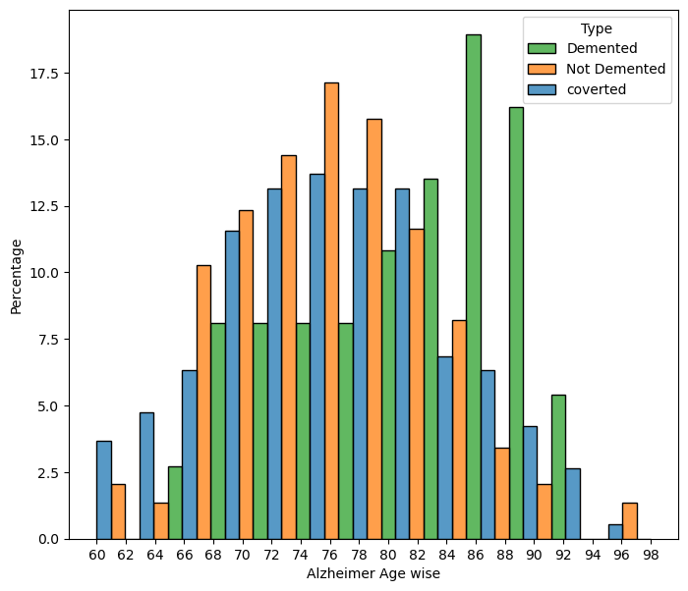
Age distribution over disease
As we know, Alzheimer's disease generally affects older adults, with people above the age of 70 being more susceptible.
The highest age group in the dataset includes individuals aged 86 to 89 years.

Slide 13
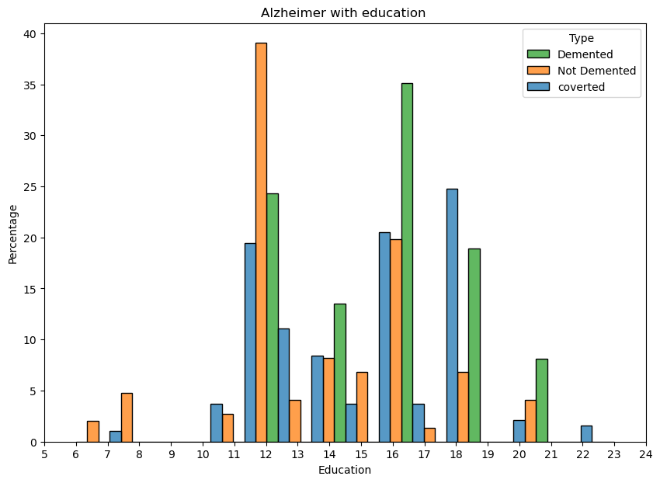
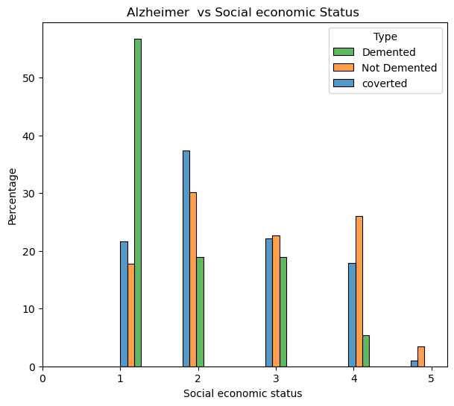
Alzheimer vs Education
Alzheimer vs SES
More educated individuals tend to have a higher risk of developing Alzheimer's disease
Individuals with a socioeconomic status of 1 i.e., low SES (poor) exhibit a higher prevalence of Alzheimer's disease

Slide 14
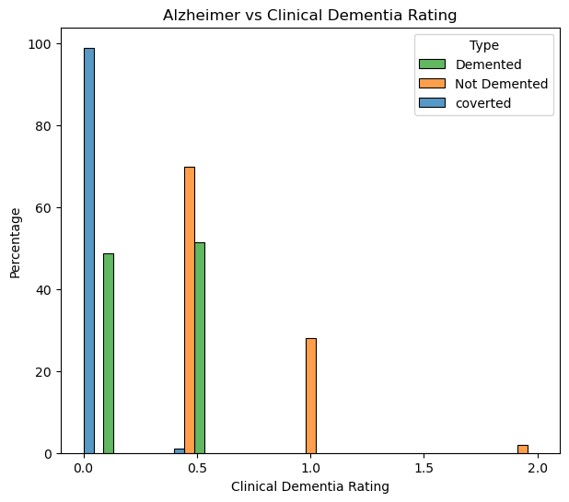
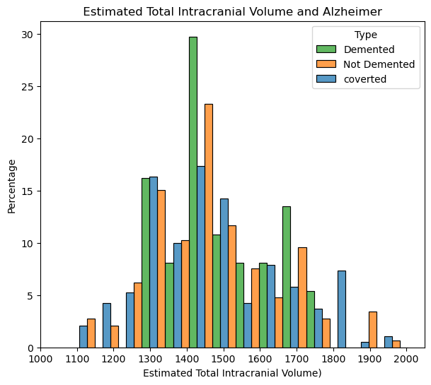
Alzheimer vs CDR
Alzheimer vs eTIV
Individuals with a Clinical Dementia Rating (CDR) score less than 1 are more likely converted to dementia And subjects in the datasets are having mild dementia
Having an Estimated Total Intracranial Volume (eTIV) of 1400 alone does not necessarily indicate a high chance of Alzheimer's disease. Alzheimer's risk is influenced by various factors, including age, genetics, education level, and cognitive function. While certain studies may suggest correlations between eTIV and Alzheimer's risk, eTIV alone is not a definitive predictor of the disease.

Slide 15
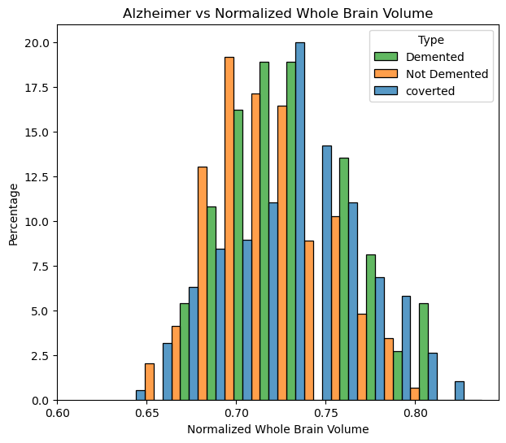
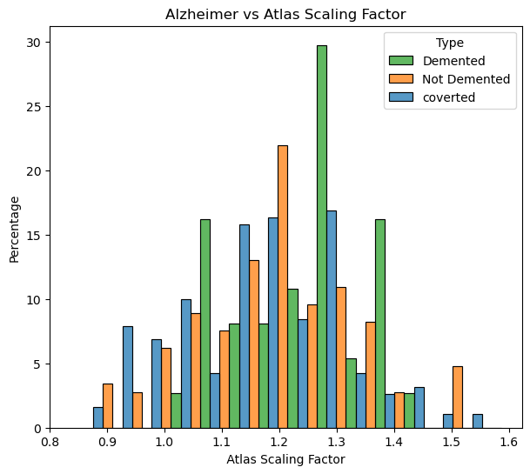
Alzheimer vs nWBV
Alzheimer vs ASF
Individuals with a Normalized Whole Brain Volume (nWBV) value above 0.7 have a higher chance of developing dementia. Normalized Whole Brain Volume is a measure used to compare brain volumes across different individuals by normalizing against the total intracranial volume, with values typically ranging from 0.5 to 0.9. higher nWBV values, especially above 0.7, are often associated with increased risk of dementia due to greater brain atrophy.
An Alzheimer's Atlas Scaling Factor (ASF) below or above 1.2 is associated with dementia. The Alzheimer's Atlas Scaling Factor typically ranges around 1.0, with values indicating the degree of scaling needed to fit an individual's MRI to a standard brain template. Significant deviations from 1.0, particularly values below or above 1.2, may be indicative of brain volume abnormalities associated with dementia.

Slide 16
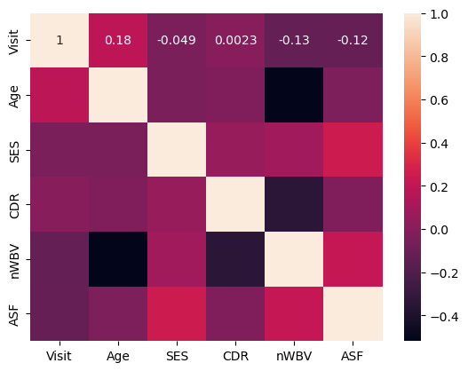
Heat Map of Variables
Explains the correlation of all numerical features.
Also we can identify if any two independent features are corelated to each other.ie., Multicollinearity.

Slide 17
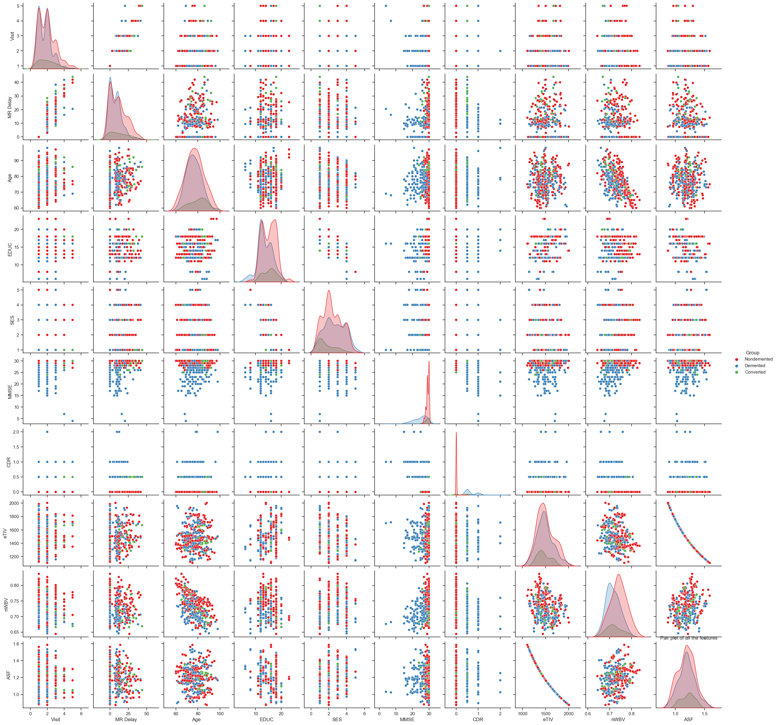
Market

Slide 18
Model Building
Encoding:
Converting categorical variables into numerical representations for machine learning algorithms.
Splitting the Data Frame:
Dividing the dataset into 2 data frames independent features and dependent feature i.e., target variable to evaluate
Train test split:
Dividing the dataset into training and testing sets to evaluate model performance.
Scaling:
Standardizing numerical features to ensure uniformity and improve model convergence during training.
Model Building

Slide 19

Model Building
Logistic Regression:
Decision Tree
Random Forest
Evaluation matrix:
Accuracy
Precision
ROC - FPR, TPR, Threshold
AUC
Confusion Matrix
Classification report

Slide 20
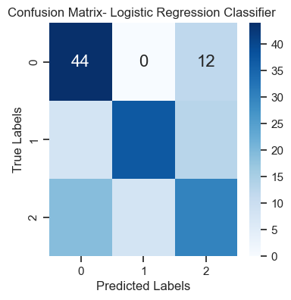
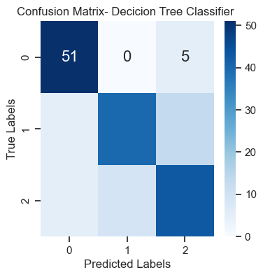
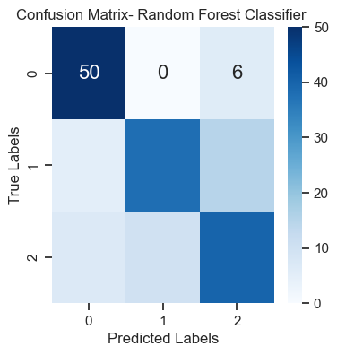
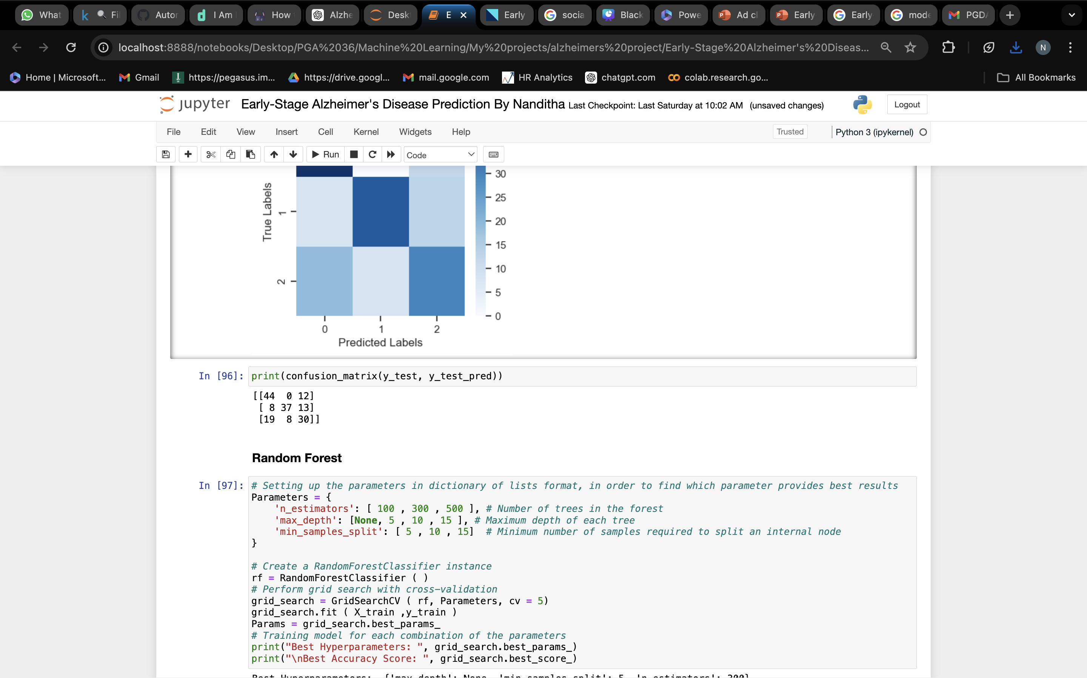
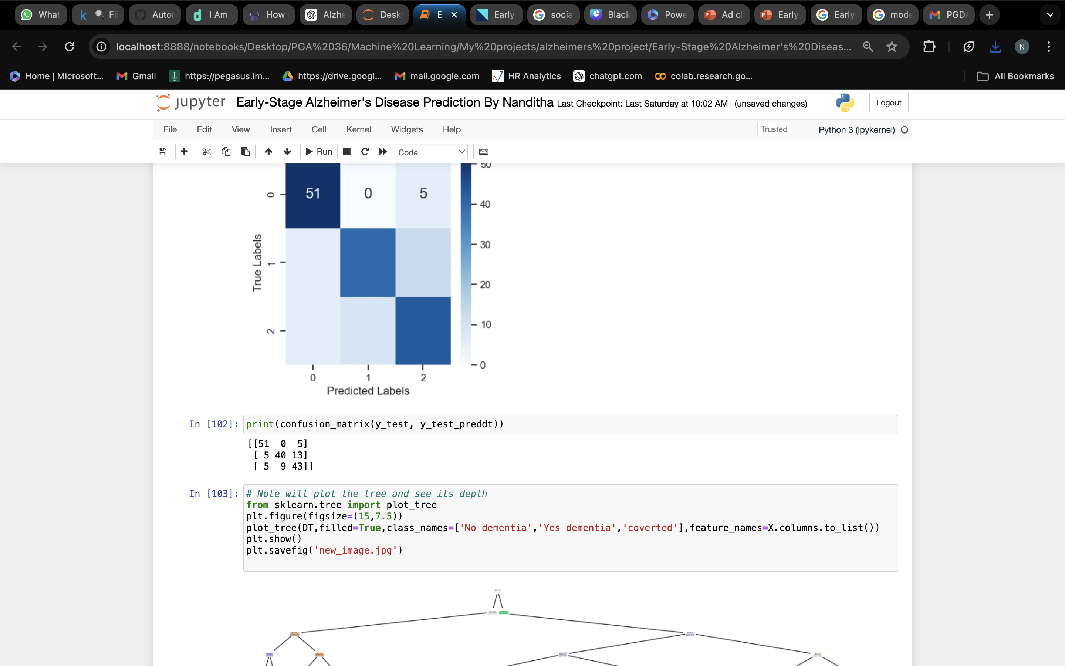
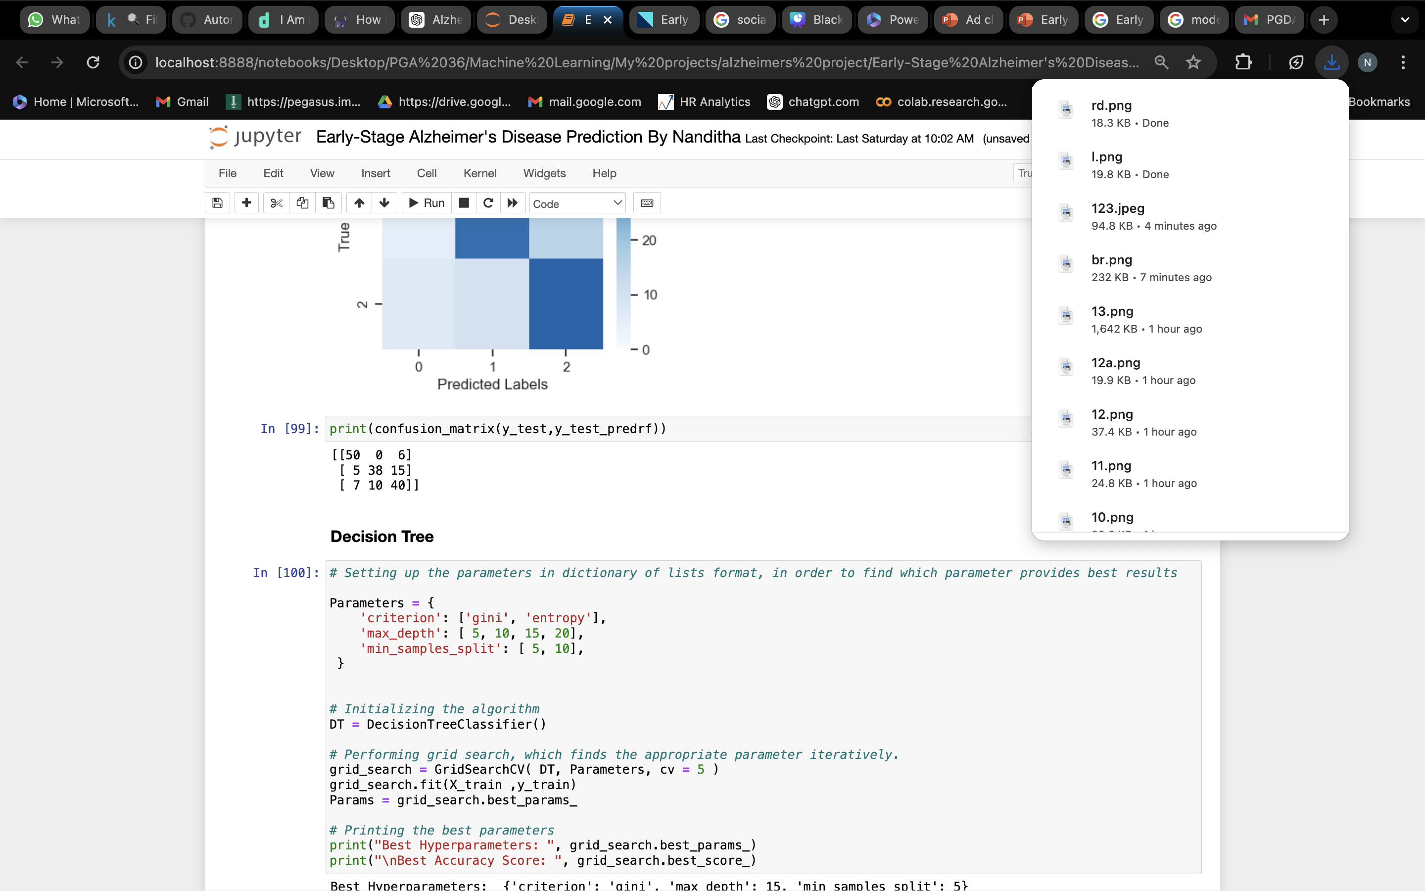
Logistic Regression
Decision
Tree
Random
Forest
Accuracy train: 0.6616541353383458
Accuracy test: 0.6491228070175439
Accuracy train: 0.9598997493734336
Accuracy test: 0.7485380116959064
Overfitted
Accuracy train: 0.9598997493734336
Accuracy test: 0.783625730994152
Overfitted

Slide 21
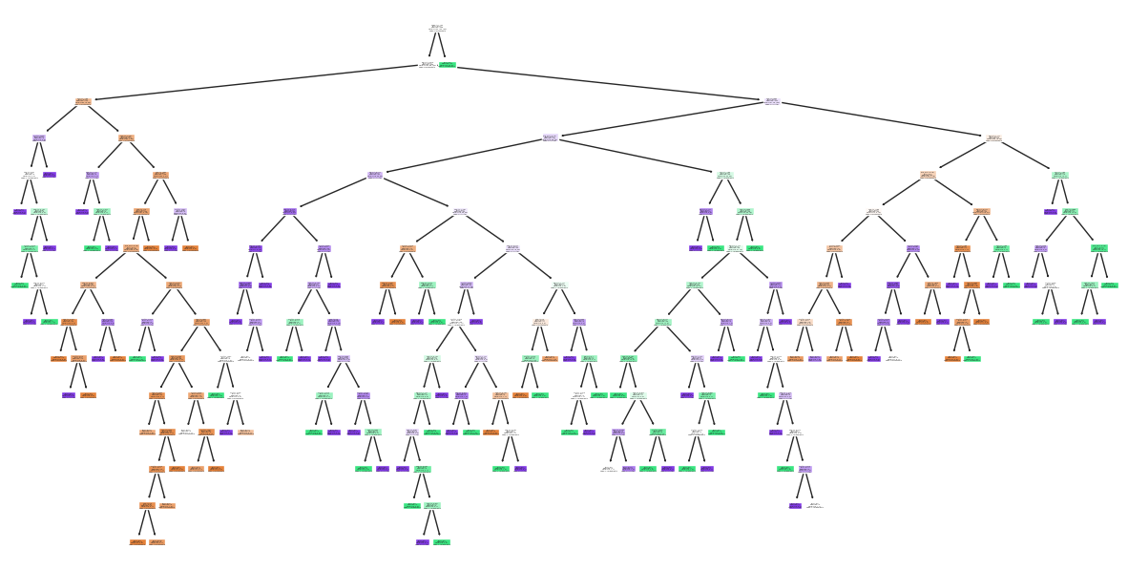
Pruning of Decision Tree
You can see over here the tree is very big because it has built to its complete depth now will pruning the tree if you won't prun the tree it leads to overfitting because it's simply learning unwanted things to its complete depth
We used Cost complexity Pruning

Slide 22
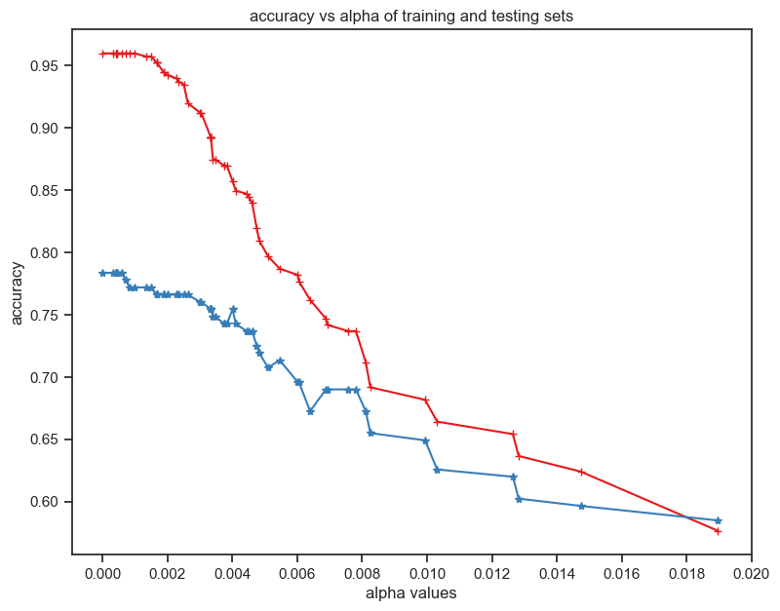
Pruning of Decision Tree
Cost Complexity pruning alpha value around 0.08 results in training and testing accuracies that are close to each other
Blue indicates the Testing accuracy
Red indicates the Training accuracy

Slide 23
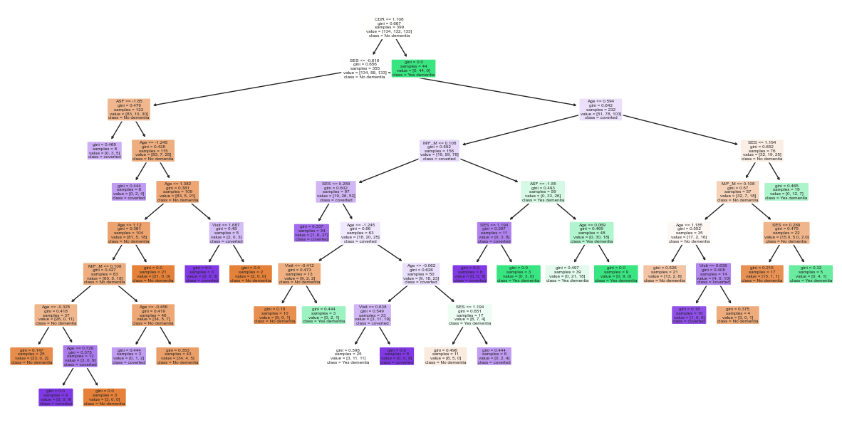
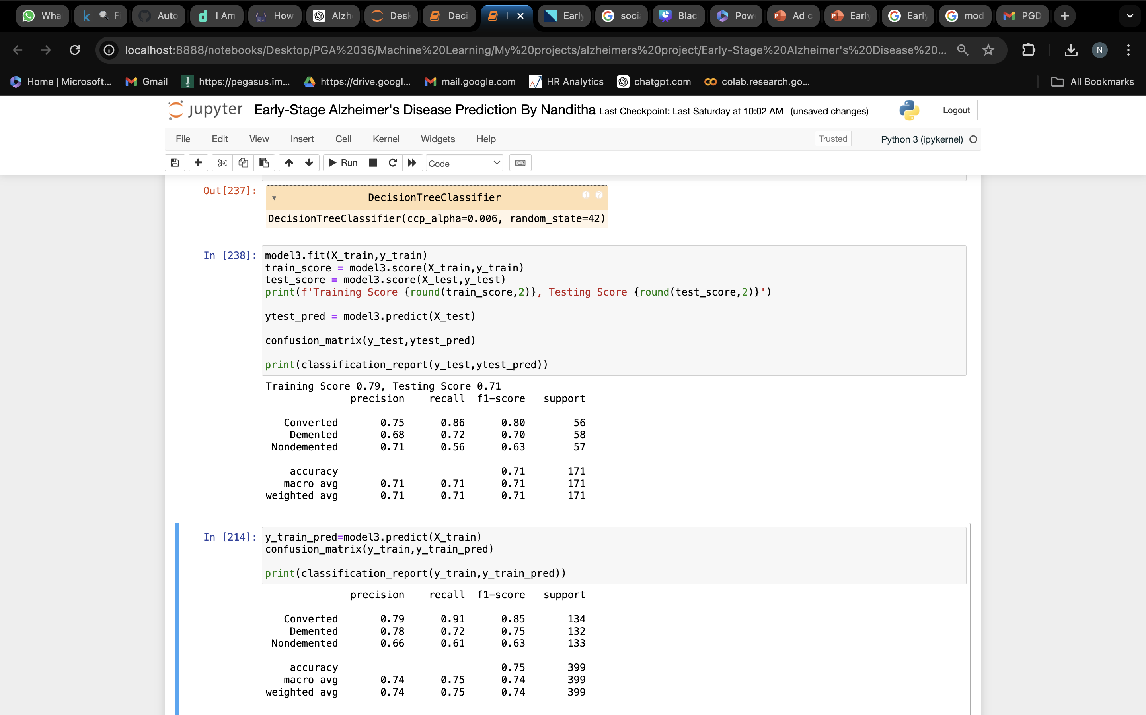
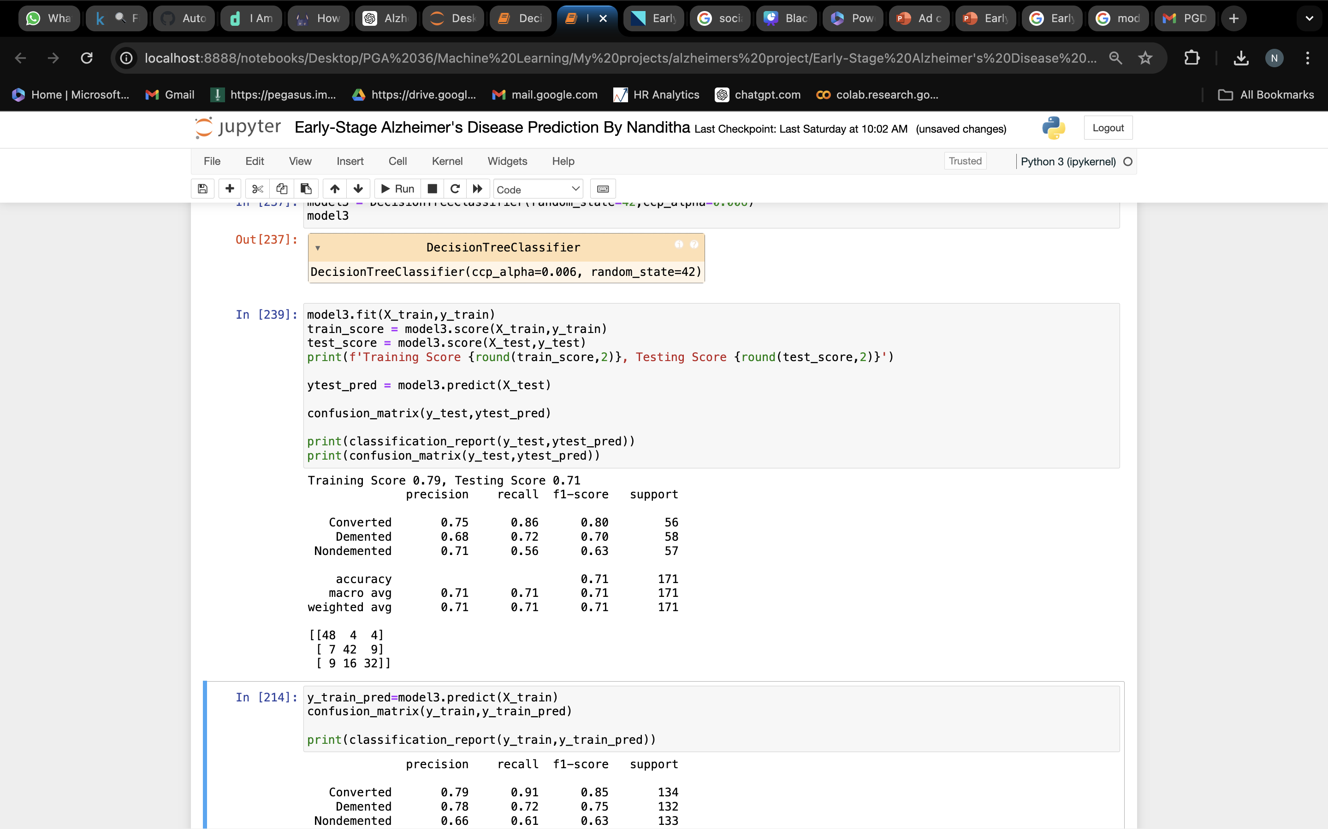
Final Decision Tree Model
Classification report of final decision tree model
Confusion matrix of final decision tree model

Slide 24

Thank You

